Slide 1
NBA Shot Prediction
Presented by – Adam Chang
Dataset #1 - NBA Shot Logs Author - DanB
Dataset #2 - NBA Players stats since 1950 Author - Omri Goldstein

Slide 2
Goal
How accurately can we predict the result of a shot?
What variables will effect the shot percentage the most?

Slide 3





Approach
Obtain
Gather Information
Extract Data
Scrub
Preprocess Data
Feature Engineering
Explore
Deriving Stats from Data
Creating Visualizations
Model
Machine Learning Algorithms
Tuning Models
Interpret
Results of the Model
Drawing up Conclusions

Slide 4
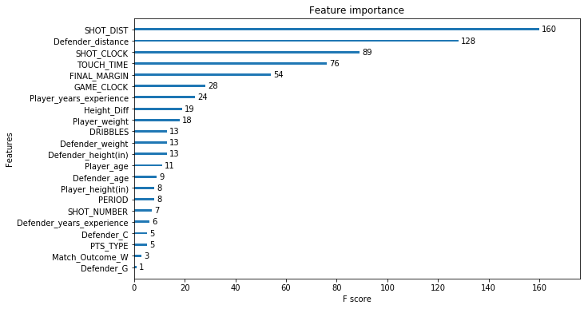
Explore

Slide 5
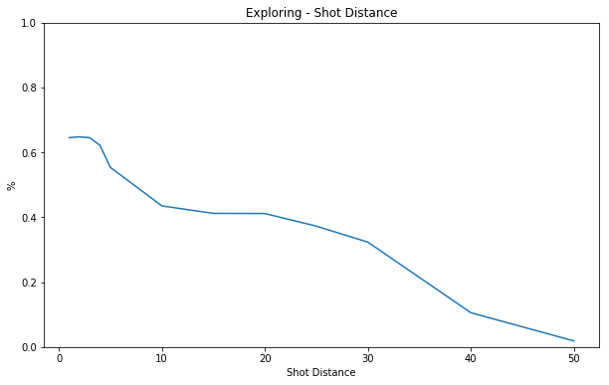
Explore

Slide 6
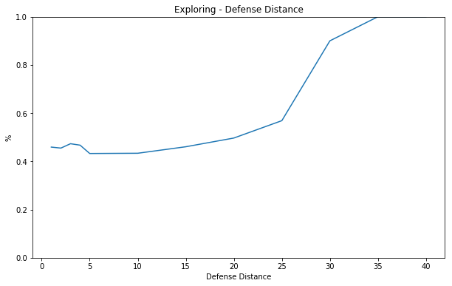
Explore

Slide 7
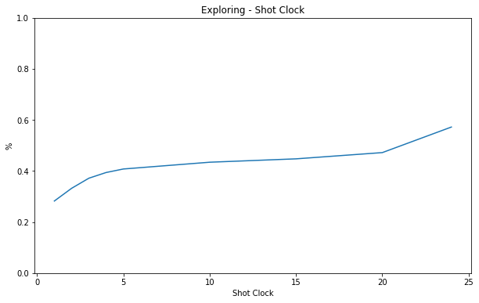
Explore

Slide 8
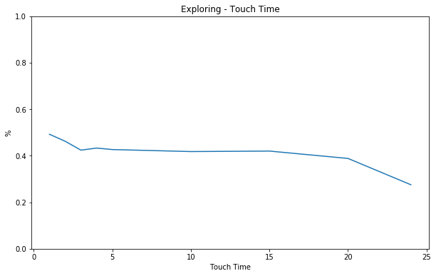
Explore

Slide 9
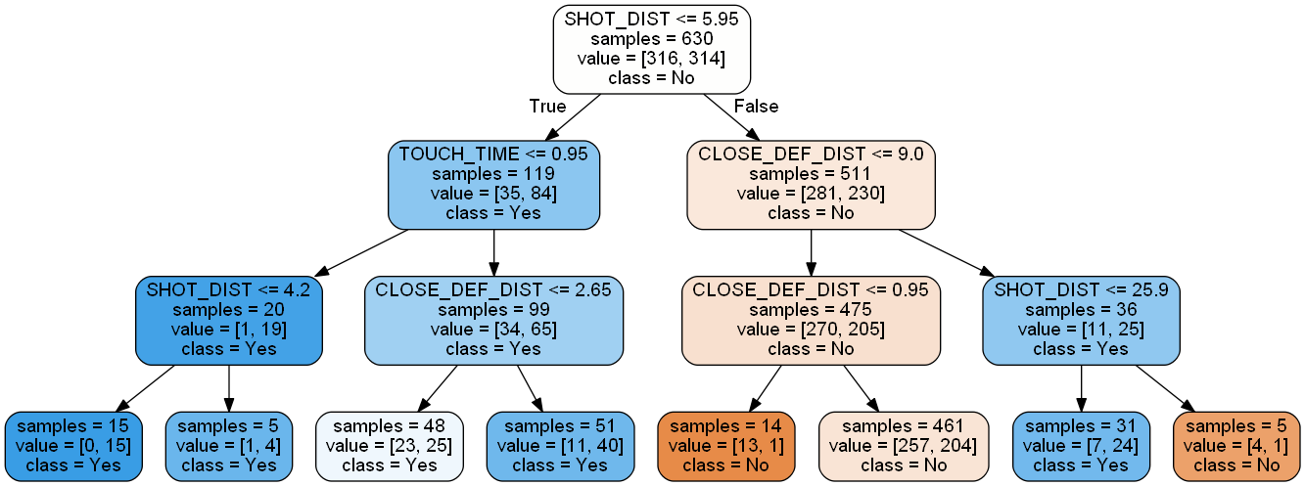
Model
Decision Tree
Blue – High Percentage of made basket
Orange – Low Percentage of made basket

Slide 10
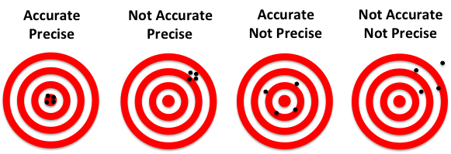
Interpretation
Accuracy Score = 62%
Precision Score = 68%
6% of games go into overtime (5 games)
28% of games ended in a margin of 5 points or less (23 games)
57% of games ended in a margin of 10 points or less (47 games)

Slide 11
Future
Splitting Data for Backcourt and Frontcourt players
Separate Dataset for 3-Point Specialists
Separate Dataset for Star Players
Adding More Data Variables
Time played when shot was taken
# of passes before shot
Include Turnover possessions
Position on court

Slide 12
Thank you
Presented by – Adam Chang
Dataset #1 - NBA Shot Logs Author - DanB
Dataset #2 - NBA Players stats since 1950 Author - Omri Goldstein

